Slide 1
QG omega equation lab 2 parts: idealized, and data
Brian Mapes
ATM 407
Fall 2021

Slide 2

Part I: COMET/MetEd
Here is a nice tool for viewing the classic “wave” view of the QG omega equation. Give it a look – notice that hovering over equation terms lights up the names for them, or vice versa.
https://www.meted.ucar.edu/labs/synoptic/qgoe_sample/

Slide 3
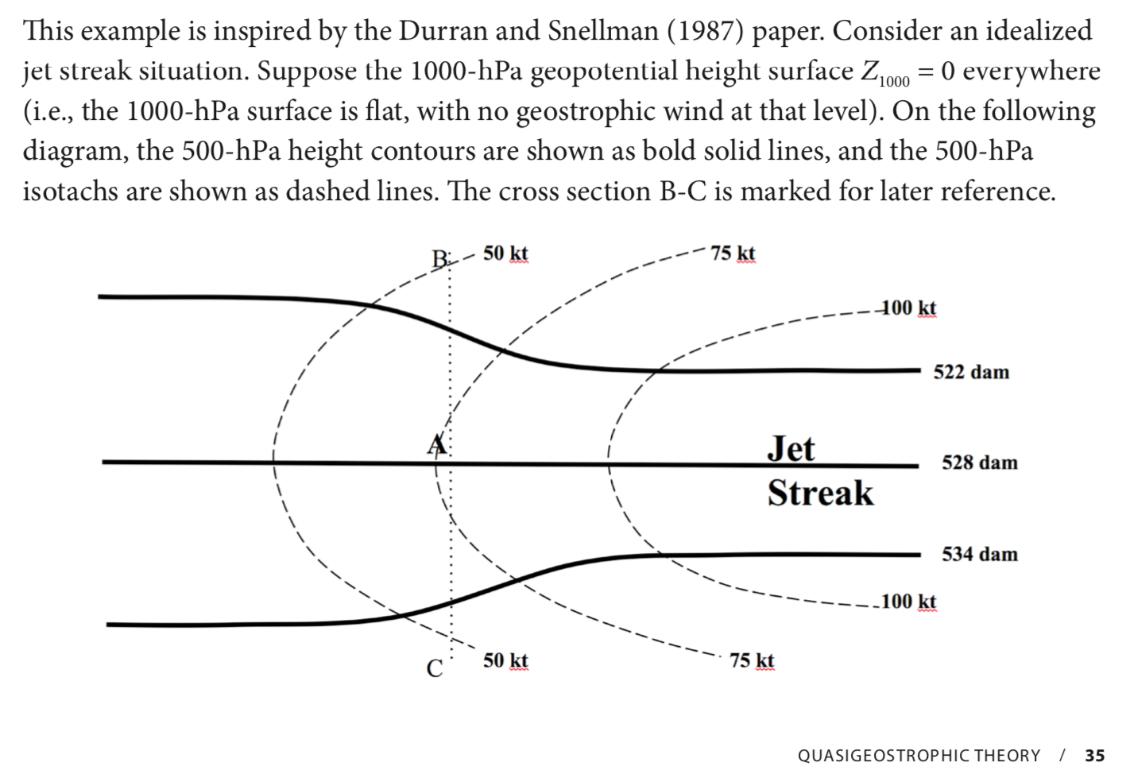
Part II: From the LMT lab book

Slide 4
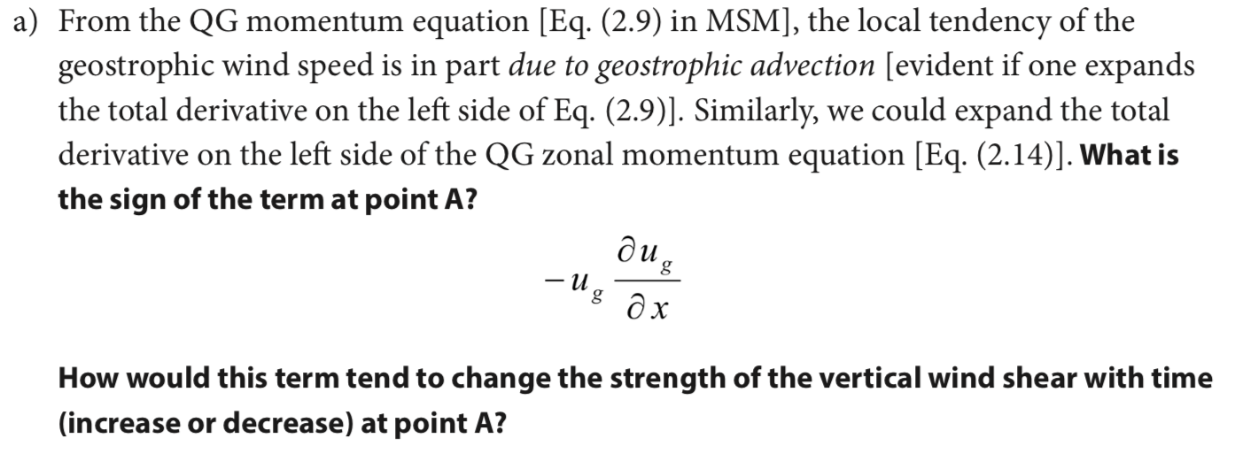
Part II: From the LMT lab book

Slide 5
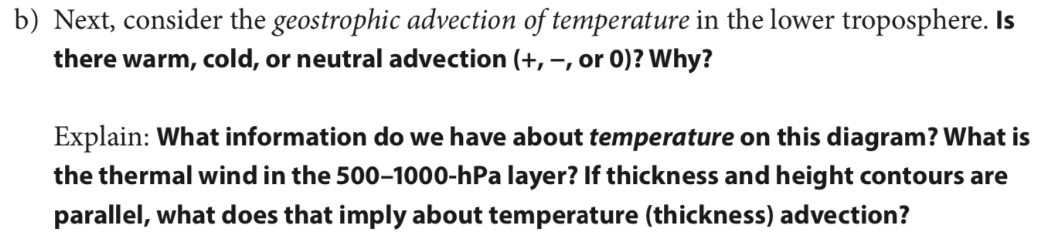
Part II: From the LMT lab book

Slide 6
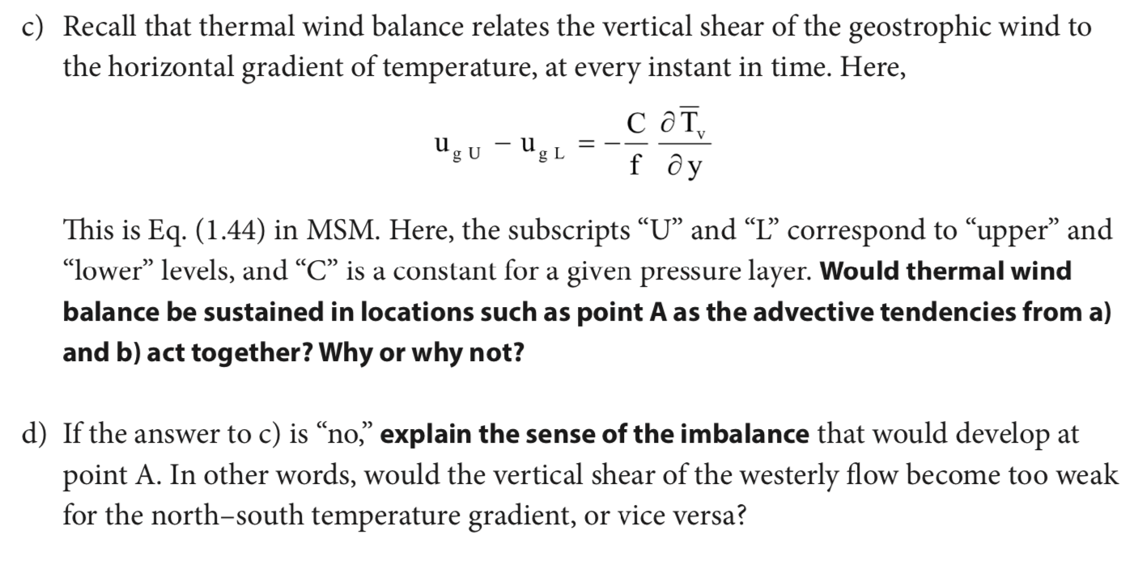
Part II: From the LMT lab book

Slide 7
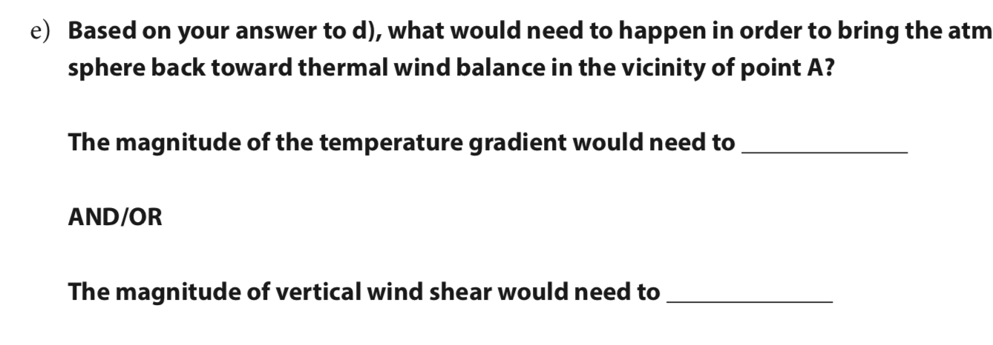
Part II: From the LMT lab book

Slide 8
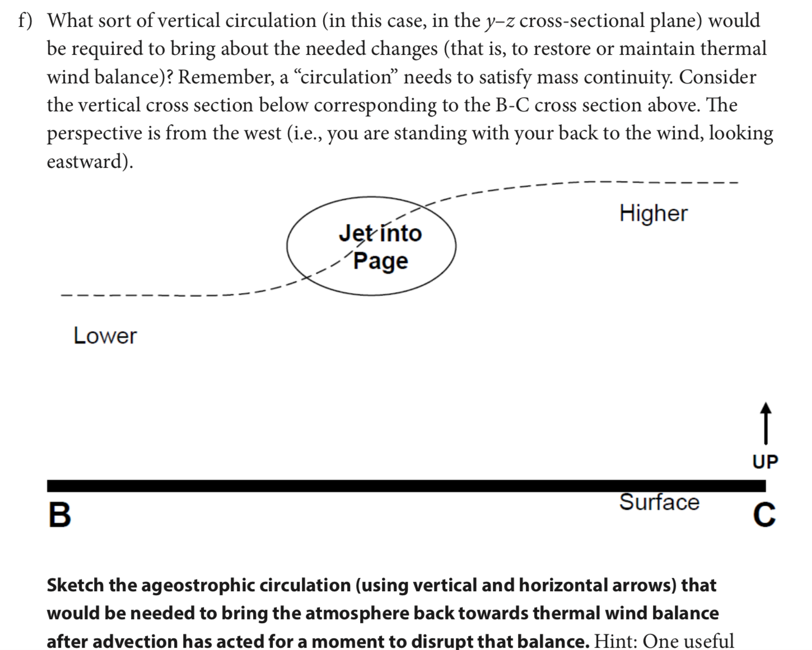
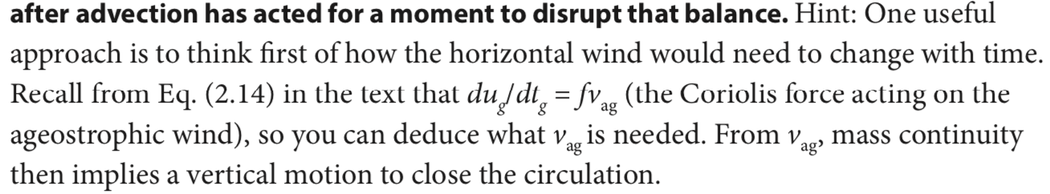
Part I: COMET/MetEd

Slide 9
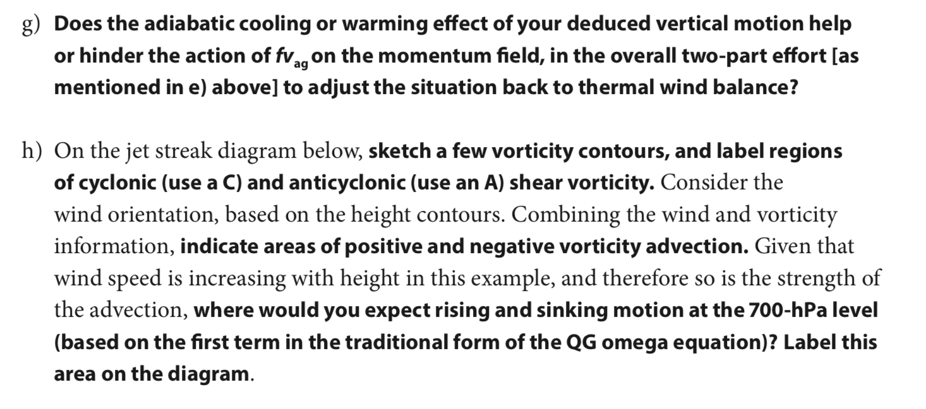
Part I: COMET/MetEd

Slide 10
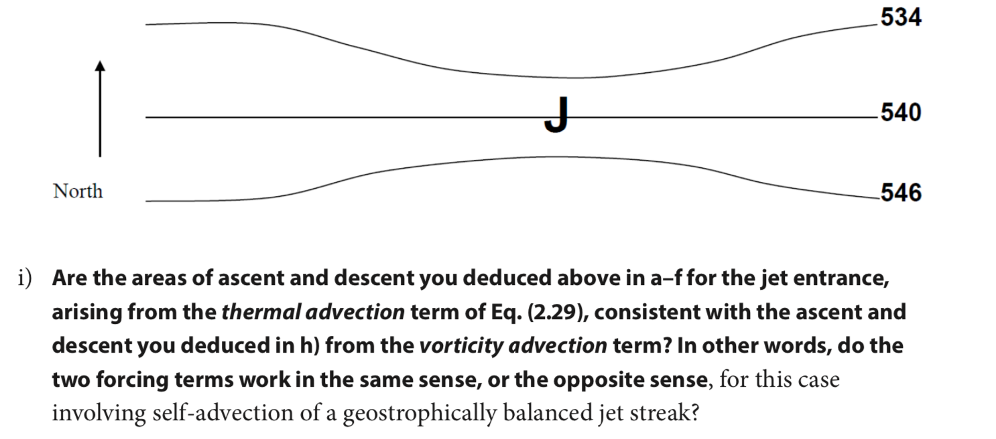
Sketch here with mouse

Slide 11
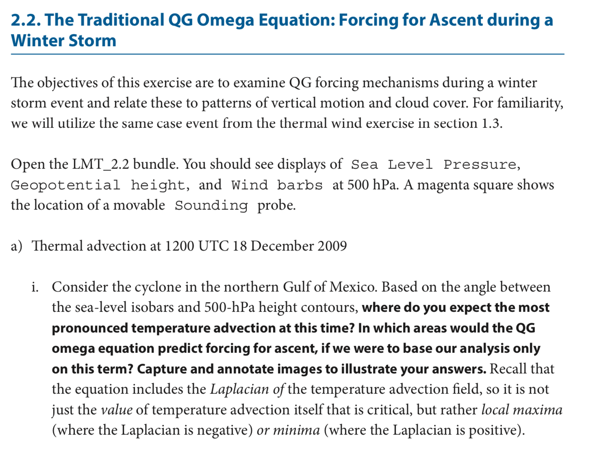
LMT2.2
Launch IDV
← From toolbar folders (there is triple redundancy) find LMT_2.2

Slide 12
LMT 2.2

Slide 13
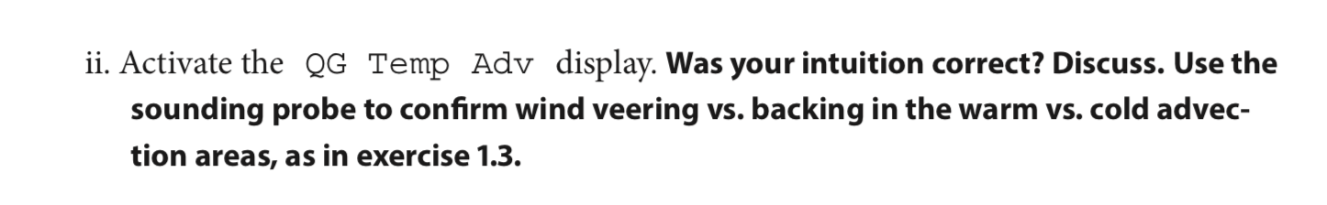
LMT 2.2

Slide 14
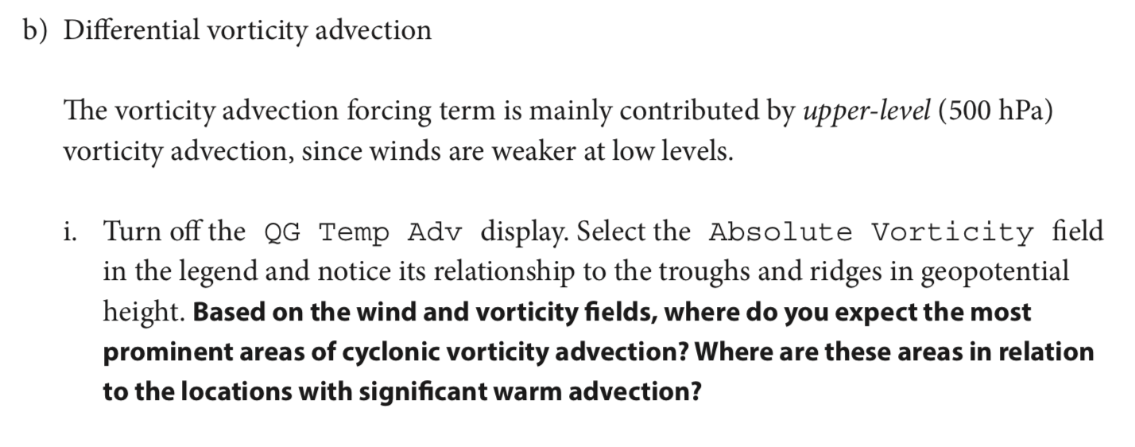
LMT 2.2

Slide 15
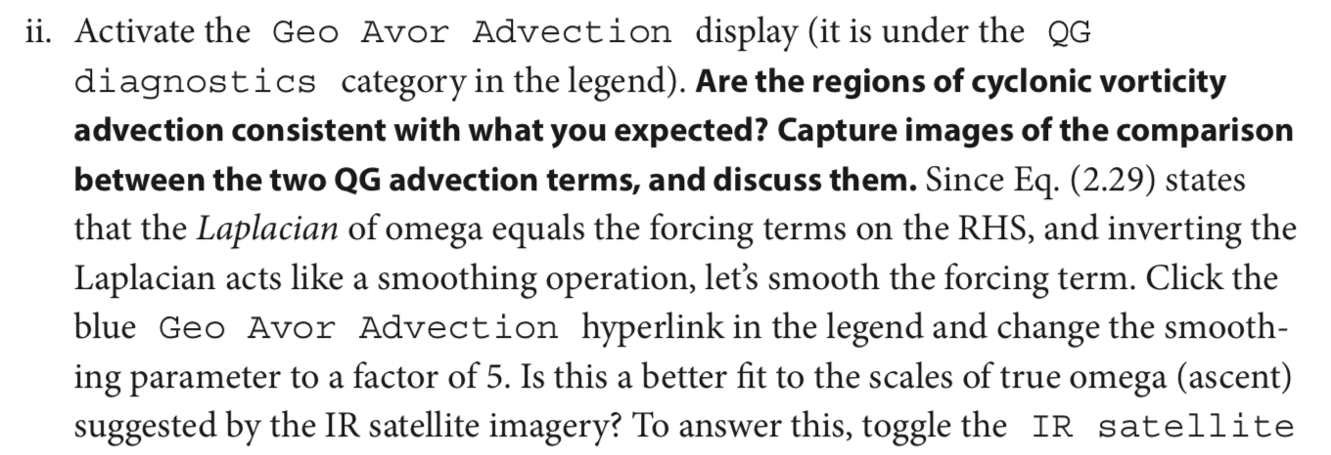
LMT 2.2

Slide 16
LMT 2.2

Slide 17
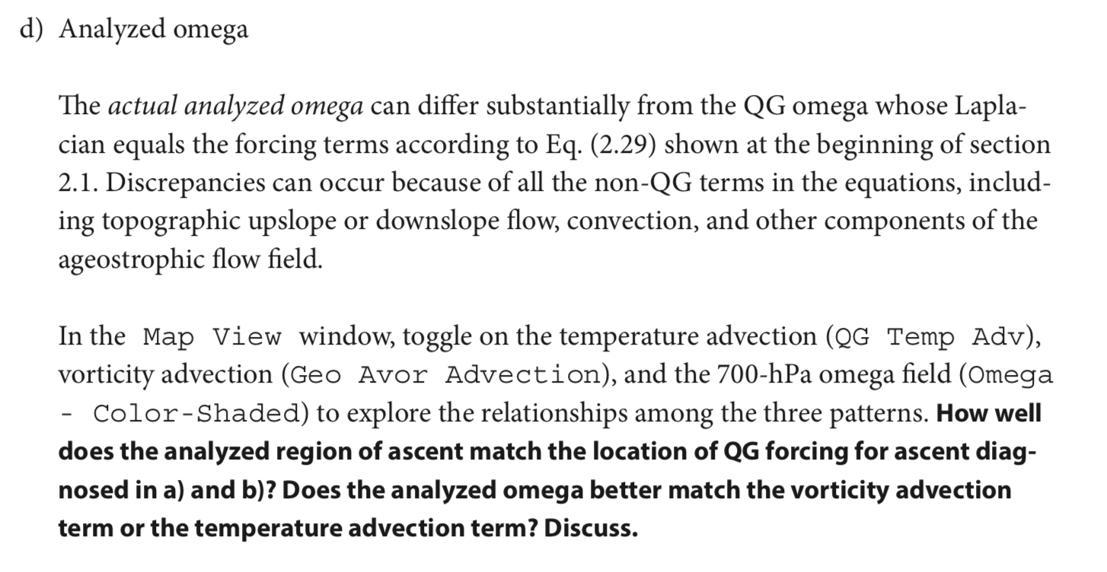
LMT 2.2

Slide 18
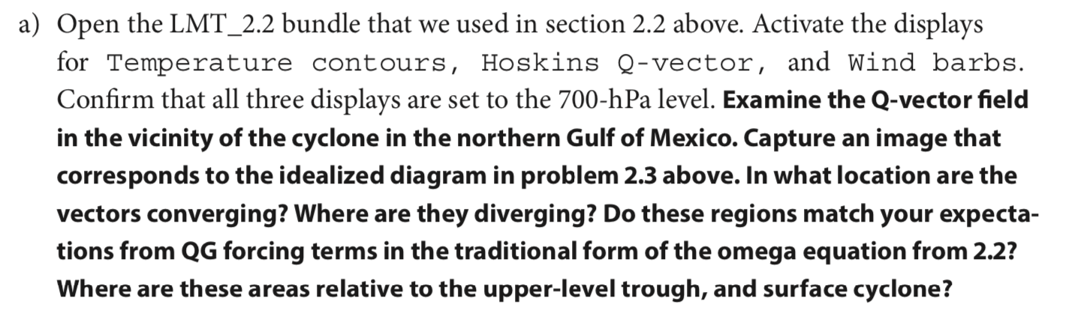
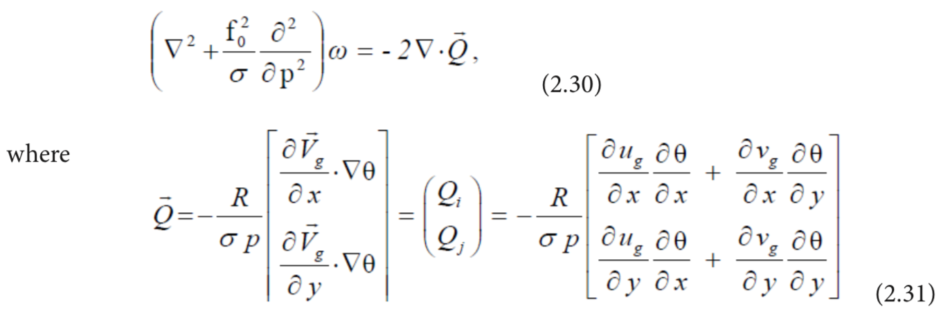
LMT 2.4 (same IDV bundle)

Slide 19
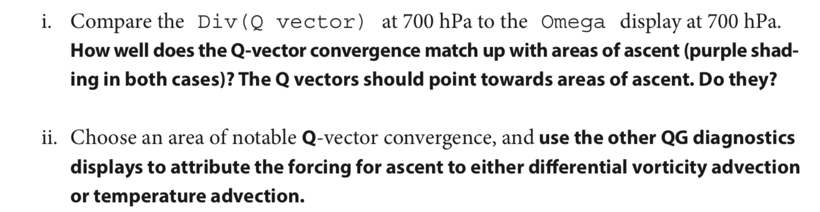
LMT 2.4 (same IDV bundle)

Slide 20
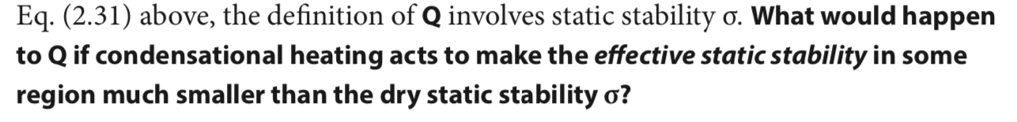
LMT 2.4 (same IDV bundle)

Slide 21
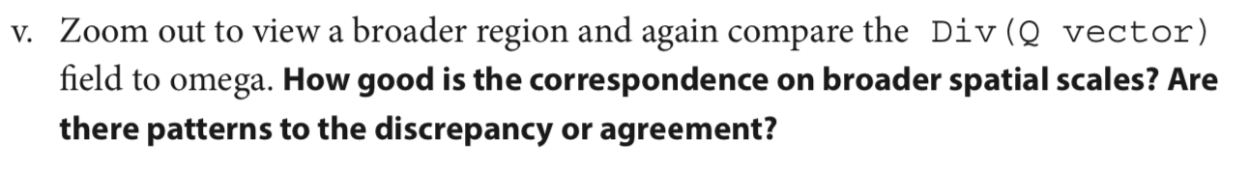
LMT 2.2

Slide 23
BACKGROUND ON QE OMEGA EQUATION

Slide 24
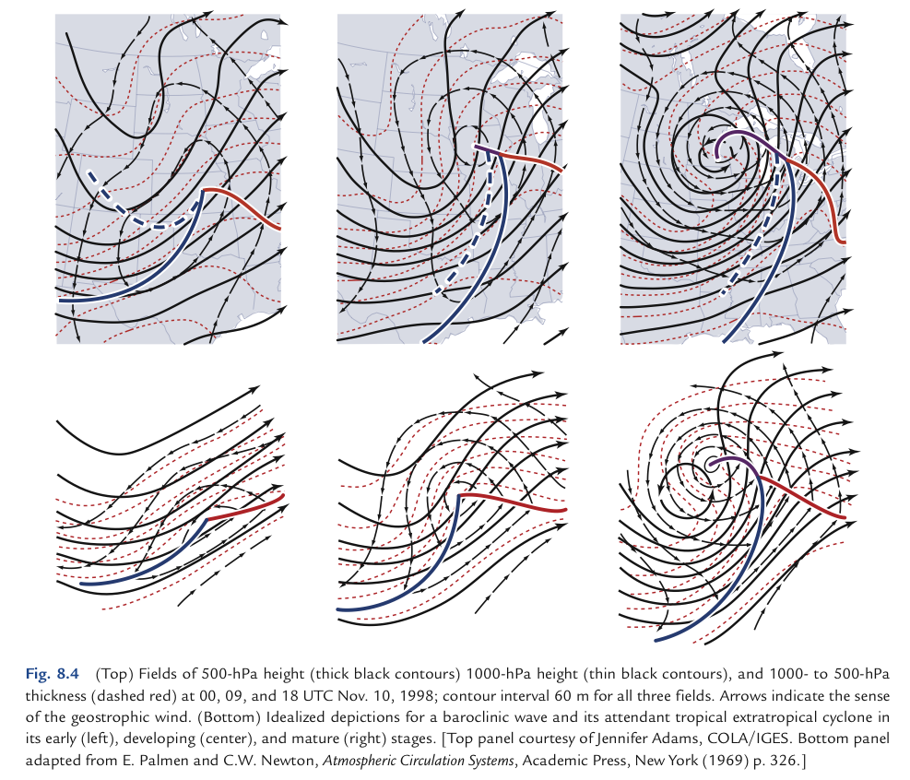
Wallace Hobbs ch8 case:
1969 textbook:

Slide 25
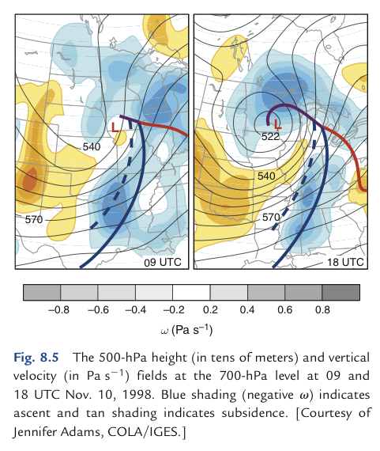
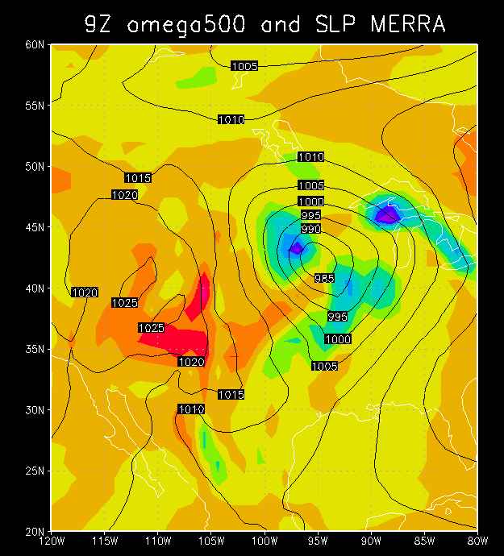
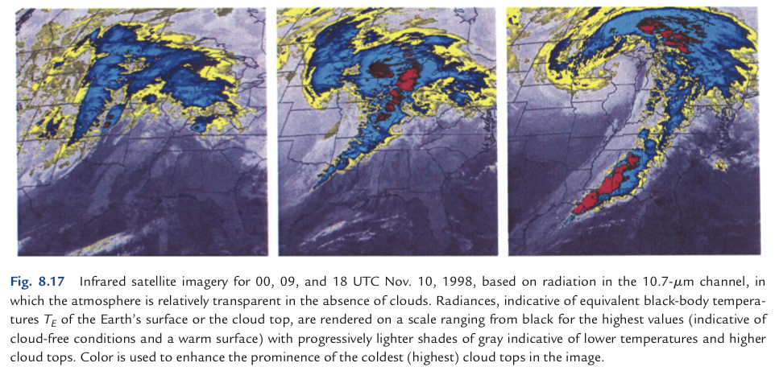

Slide 26
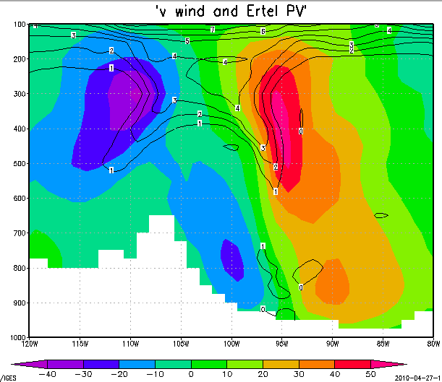

Slide 27
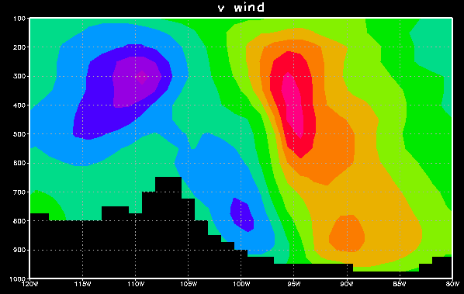
wind out of page
wind into page
cyclonic
(Trof on map)
cyclonic
Rockies
sfc Low

Slide 28
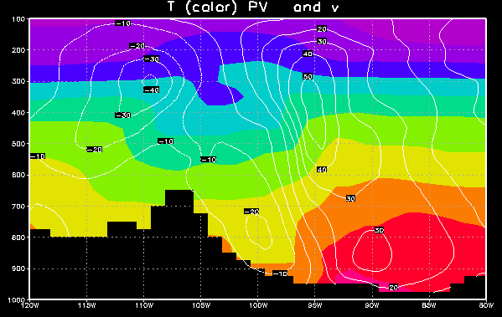

Meridional T advection
cooler air flowing south
warmer air flowing north
Low

Slide 29
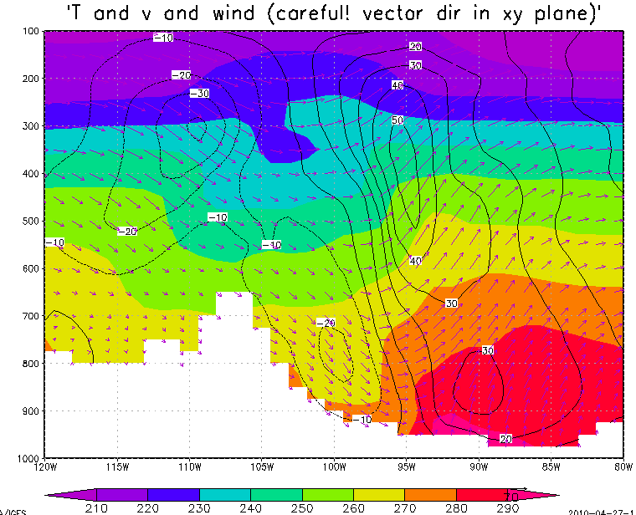
Veering/backing and T advection
TROF
winds backing with height
winds veering with height
cool air flowing south
cool air flowing south
warm air flowing north
warm air flowing north
Low

Slide 30
The omega equation
Why is there upward motion ahead of these upper-level troughs/ cyclonic vortices?

Slide 31
The omega equation
Why is there upward motion ahead of these upper-level troughs/ cyclonic vortices?
A: In order to maintain thermal wind balance, which holds across time, and thus we know logically it has a maintenance mechanism, as advection would tend to break the balance which holds at any one instant
Main mechanism: cooling by upward motion in a stratified fluid.

Slide 32
v and T: thermal wind balance
warm core above
cyclonic
(Trof)
cold core = low thickness
warm core
cyclonic
Low

Slide 33
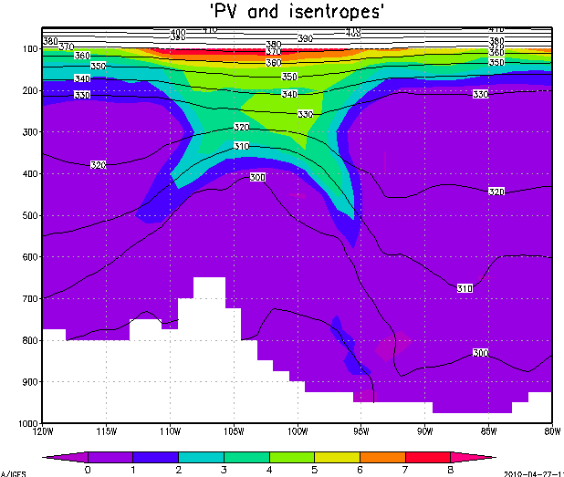


cyclonic ζ
(Trof)
Thermal wind balance prevails: There is a Z trough (trof) for geostrophic balance, with a cold core beneath it, supporting it hypsometrically (in hydrostatic balance).

Slide 34

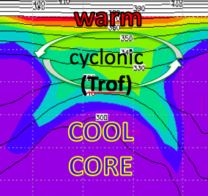

Unsheared advection of T, u, v, vort, PV:
no problem, whole structure moves
cyclonic
(Trof)

Slide 35


Sheared advection breaks thermal wind balance
cyclonic ζ
(Z trof)

Slide 36


Sheared advection breaks thermal wind balance
Z Trof

Slide 37
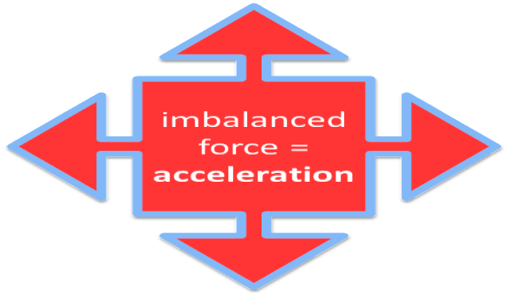
Sheared advection breaks thermal wind balance
Z Trof
L

Slide 38
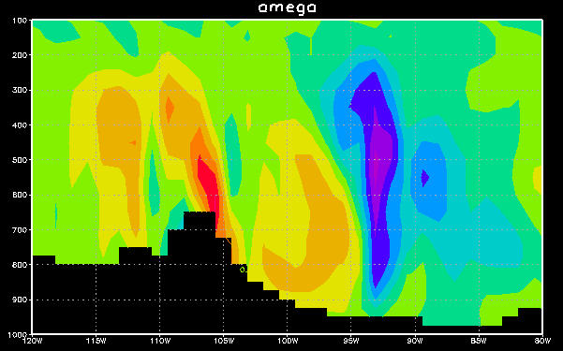
East-west section: omega
→ Z Trof
in order
to create the
needed
cool core
(low ΔZ),
so balance
can again prevail
…

Slide 39
Warm horizontal advection demands even more upward motion, if the cool core is to be built
TROF
cool air flowing south
warm air flowing north
warm air flowing north

Slide 40
East-west section: omega
to build
Z Trof
ascent
creates the
needed
cool core
(low ΔZ),
so that balance
can again prevail
…

Slide 41
Vertical motion and clouds

